Slide 1
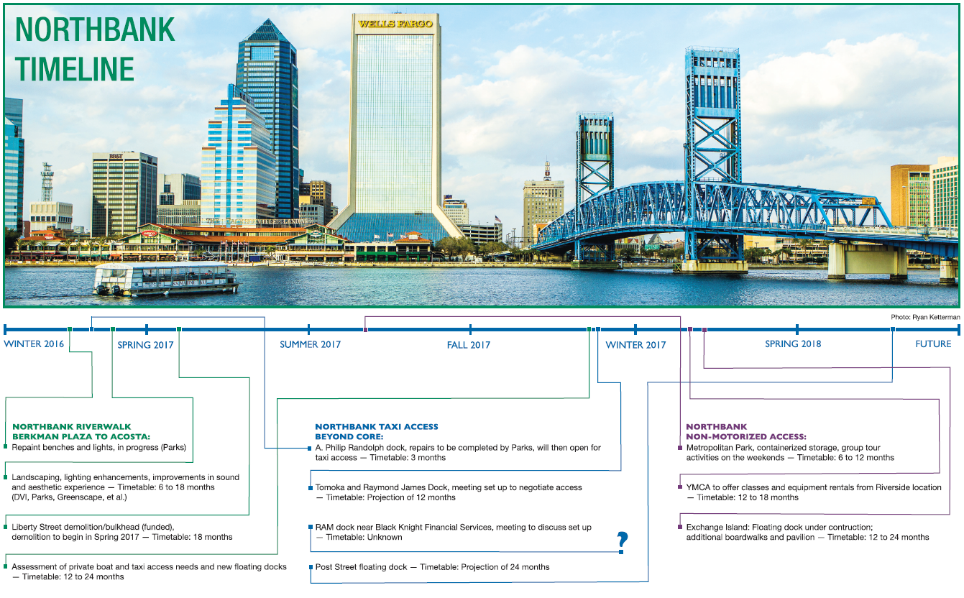
DOWNTOWN UPDATE
February 2017

Slide 2
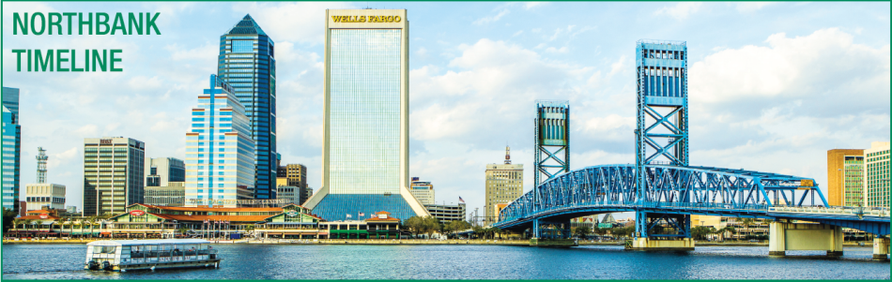

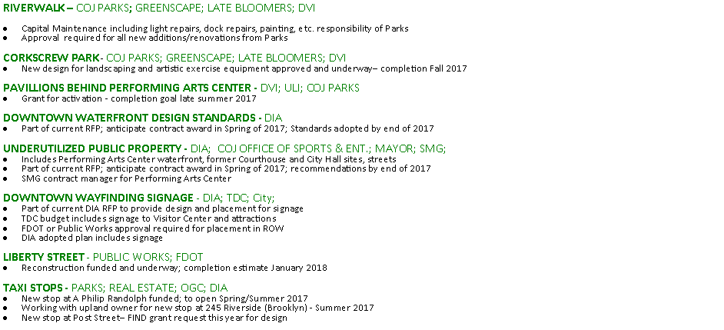
DOWNTOWN UPDATE
February 2017

Slide 3
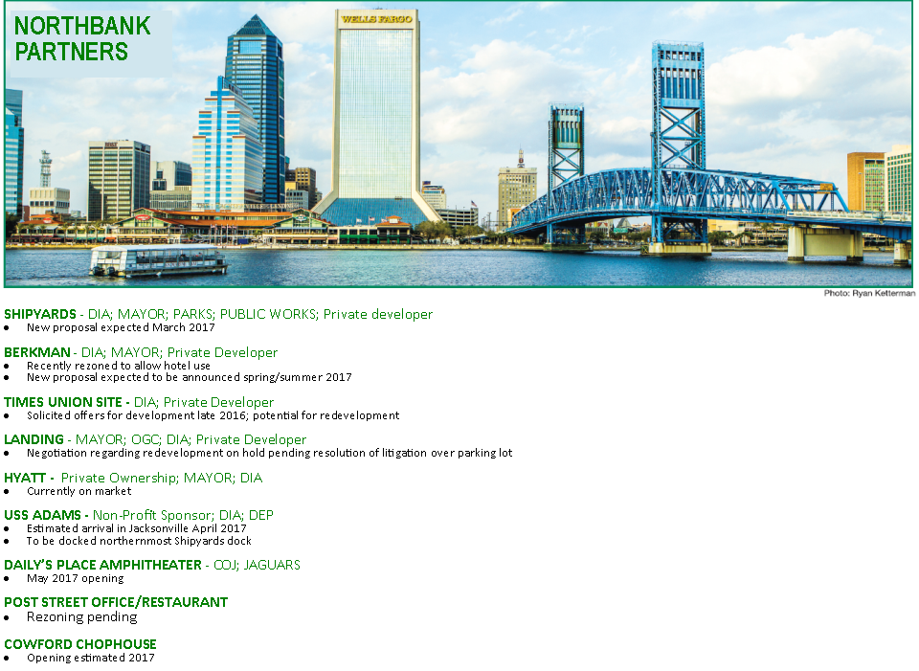

DOWNTOWN UPDATE
February 2017

Slide 4
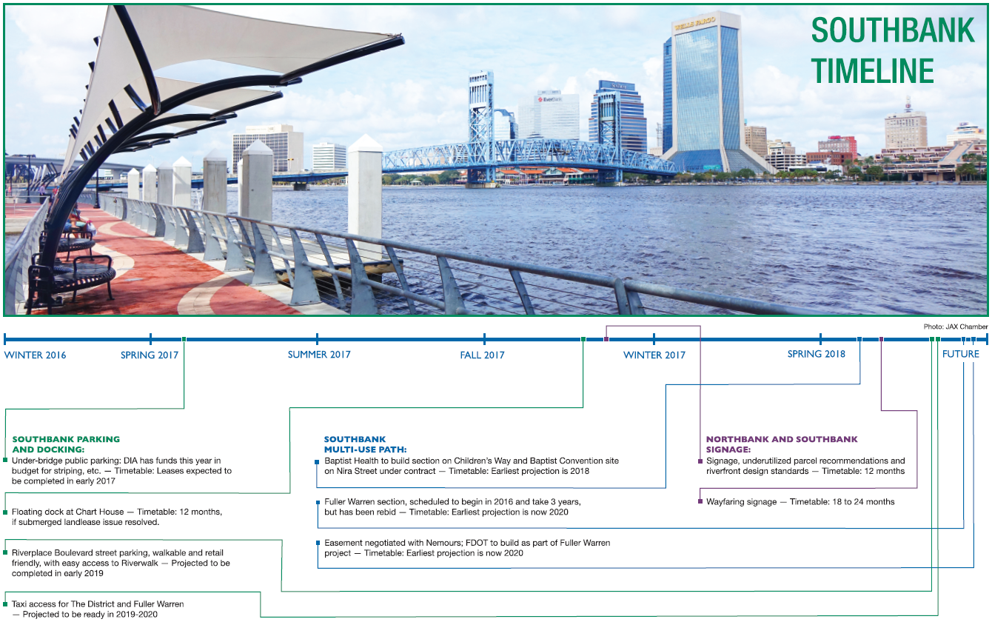
DOWNTOWN UPDATE
February 2017

Slide 5
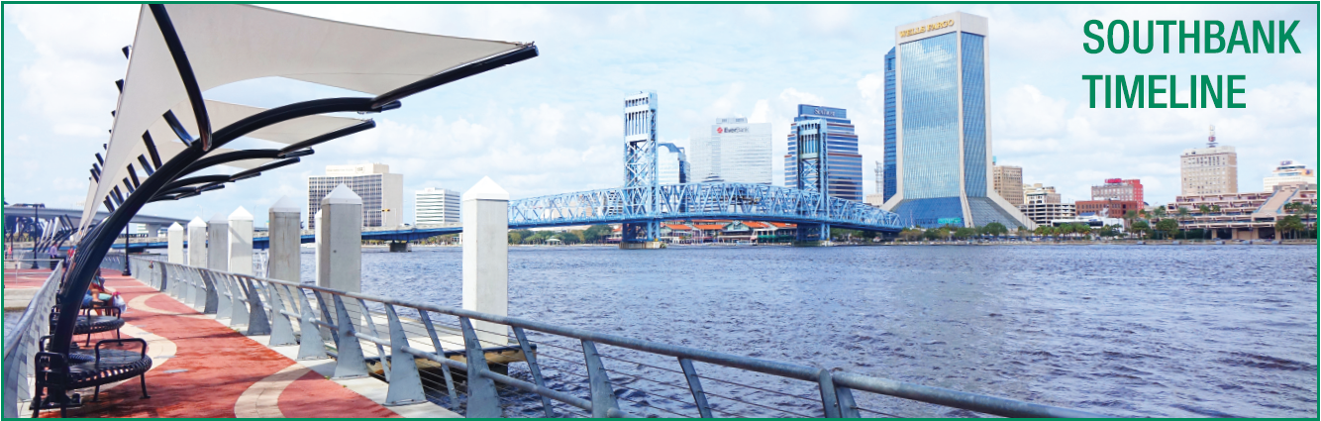

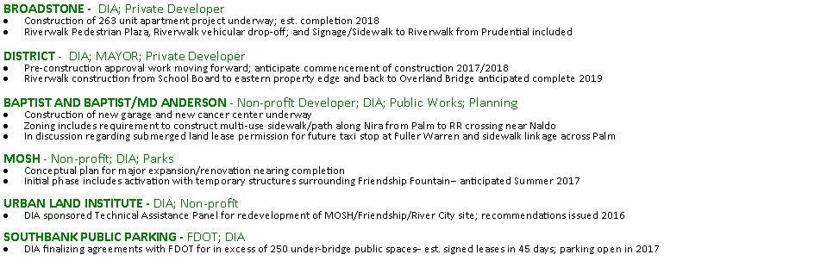
DOWNTOWN UPDATE
February 2017

Slide 6


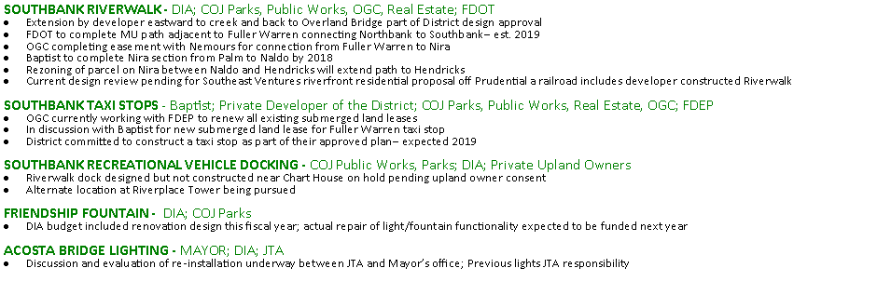
DOWNTOWN UPDATE
February 2017

Slide 7
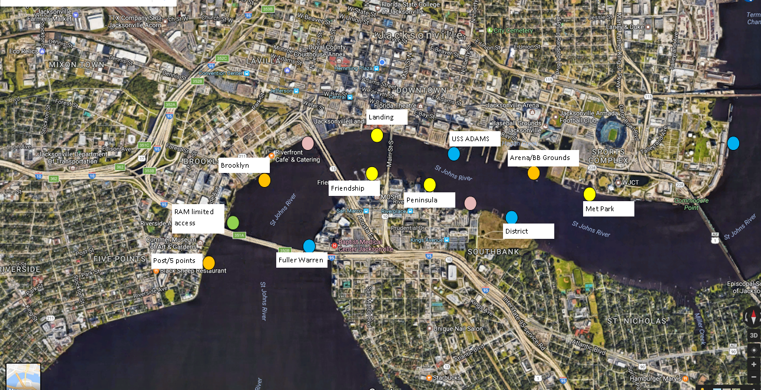
February 2017
DOWNTOWN UPDATE

